Slide 2
KubeStellar - Making Multi-Cluster Fleet Management as Easy as using a Single Cluster
Andy Anderson

Slide 3


Andy Anderson
github.com/kubestellar/kubestellar
Software Architect
IBM Research
andrew.anderson@ibm.com
@clubanderson

Slide 4

Commercial Break
Notes:
This is KubeCon/Cloud NativeCon, so I need to show the CNCF landscape picture.

Slide 5

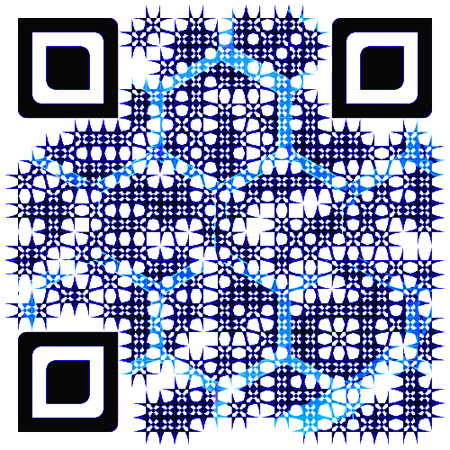
KUBESTELLAR uses standards deployment tools, not bundles
Centrally define and deploy Kubernetes resources across multiple clusters
Use standard deployment tools (kubectl, helm, ArgoCD, Flux) no bundling
Make disconnected cluster operation possible
Designed for scalability with 1:many and many:1 scenarios
Modular design to ensure compatibility with CNCF tools
© 2023 IBM Corporation

Slide 6
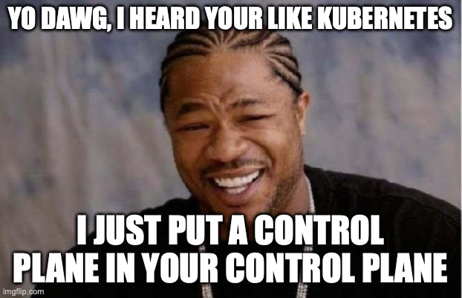

Slide 7
KUBESTELLAR virtual clusters (Spaces) are our secret
KubeStellar uses lightweight virtual clusters (Spaces) that run inside the KubeStellar hosting cluster
Standard Kubernetes clusters have 2-300 api-resources, KubeStellar Spaces have only 40
Fewer api-resources mean deployments and jobs remain denatured – they do not expand into other resources like replicasets, pods, etc.
Denaturing is the key to accepting native, unbundled Kubernetes resources as input
Unbundled resources are the preferred output of most CNCF tools making KubeStellar use and integration easy
Kubernetes | KUBESTELLAR
kubectl api-resources | wc –l 281 | kubectl api-resources | wc –l 40
© 2023 IBM Corporation
© 2023 IBM Corporation

Slide 8
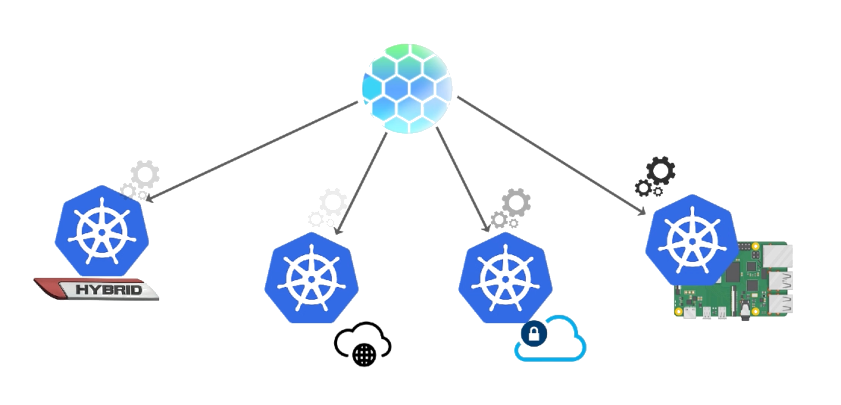
KUBESTELLAR treats multiple Kubernetes cluster as one
Hybrid, Public, Private, Edge - Create One Configuration, Deploy Many
© 2023 IBM Corporation

Slide 9
KUBESTELLAR treats multiple Kubernetes cluster as one
© 2023 IBM Corporation

Slide 10
KUBESTELLAR treats multiple Kubernetes cluster as one
INVENTORY
WORKLOADS
BINDING POLICY
© 2023 IBM Corporation

Slide 11
KUBESTELLAR treats multiple Kubernetes cluster as one
1. Register Clusters
INVENTORY
WORKLOADS
BINDING POLICY
prod-cluster-A
stage-cluster-A
dev-cluster-A
…
© 2023 IBM Corporation

Slide 12
KUBESTELLAR treats multiple Kubernetes cluster as one
2. Apply Workload(s)
INVENTORY
WORKLOADS
BINDING POLICY
prod-cluster-A
stage-cluster-A
dev-cluster-A
…
myApp-dev-0.2
ollamaInf-prod-1.0
…
© 2023 IBM Corporation

Slide 13
KUBESTELLAR treats multiple Kubernetes cluster as one
3. Apply Binding
Binding Policy 1:
workload: myApp-dev-0.2
inventory: dev-cluster-A
INVENTORY
WORKLOADS
BINDING POLICY
prod-cluster-A
stage-cluster-A
dev-cluster-A
…
myApp-dev-0.2
ollamaInf-prod-1.0
…
© 2023 IBM Corporation

Slide 14
KUBESTELLAR treats multiple Kubernetes cluster as one
3. Apply Binding
Binding Policy 2:
workload: ollamaInf-prod-1.0
inventory: prod-cluster-A
INVENTORY
WORKLOADS
BINDING POLICY
prod-cluster-A
stage-cluster-A
dev-cluster-A
…
myApp-dev-0.2
ollamaInf-prod-1.0
…
© 2023 IBM Corporation

Slide 15


KUBESTELLAR showcased integrations
Software Defined Farm (SDF) – Partnership with Cornell University – advancing agriculture featuring disconnected operations
Kueue – job queuing for HPC workloads (AI) across multiple clusters Kubernetes clusters
© 2023 IBM Corporation
© 2023 IBM Corporation

Slide 16
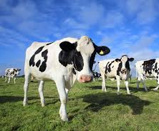
What can KubeStellar help you manage? Anything!
Cows, Apples, and Grapes
Sustainable growing environments
Reduction in amount of water and nitrates required
Pro-actively managing sickness in dairy cattle
Monitoring milk and fruit production to improve yield

Slide 17
What can KubeStellar help you manage? Anything!
Cows, Apples, and Grapes
Disconnected operations by default
Farms may have dial-up, 3G, or 4G network access depending on reachability of service
Kubernetes marks available nodes as un-schedulable after 40 seconds offline
KubeStellar tolerates indefinite periods of disconnect by design and uses bandwidth efficiently when available

Slide 18
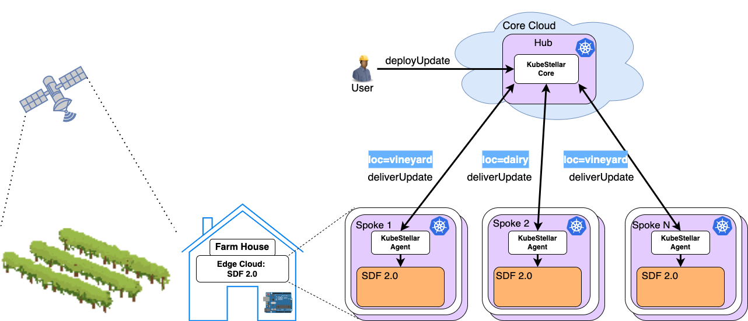
Software Defined Agriculture
1
Apply Workload(s)
Binding Policy
Pull and apply
workloads
Reply with Status
2
3
1
4
2
4
3

Slide 19
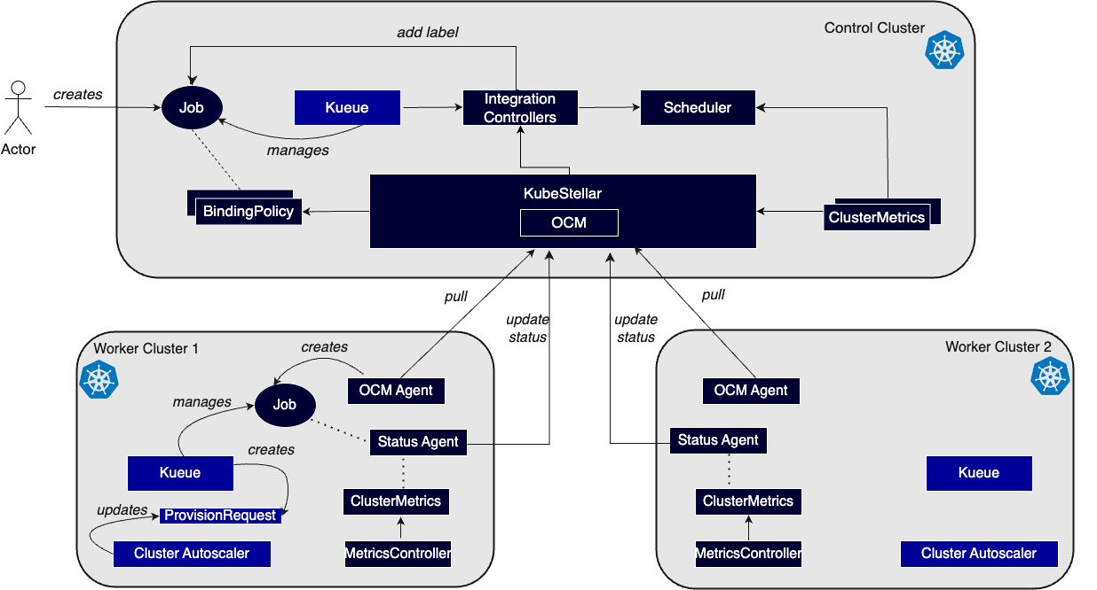


Keynote: AI running across multiple clusters with Kueue and KubeStellar
1
Apply Job(s)
Binding Policy
Pull and apply
workloads
Reply with Status
2
1
3
4
2
3
3
4

Slide 20
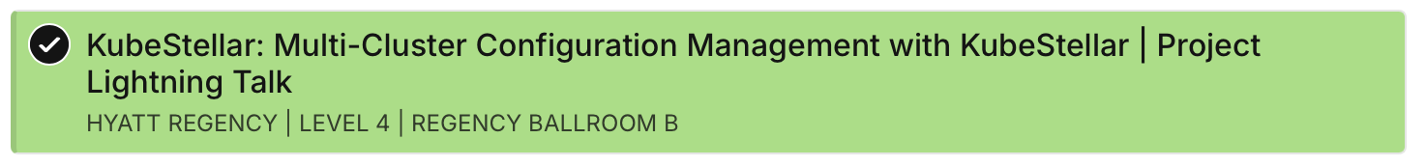
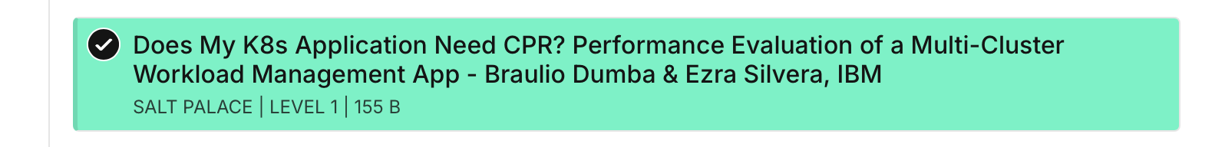
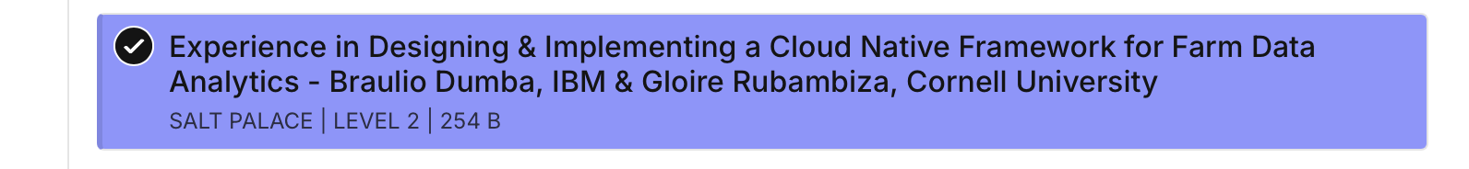

Where can I find KubeStellar at KubeCon NA 2024?
© 2023 IBM Corporation
Tuesday
@11:30
Wednesday
@2:30
Wednesday
@4:30
YOU ARE
HERE
KUBESTELLAR.IO/JOINUS
20

Slide 21
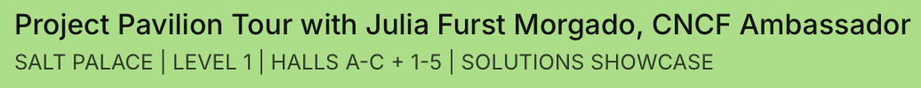
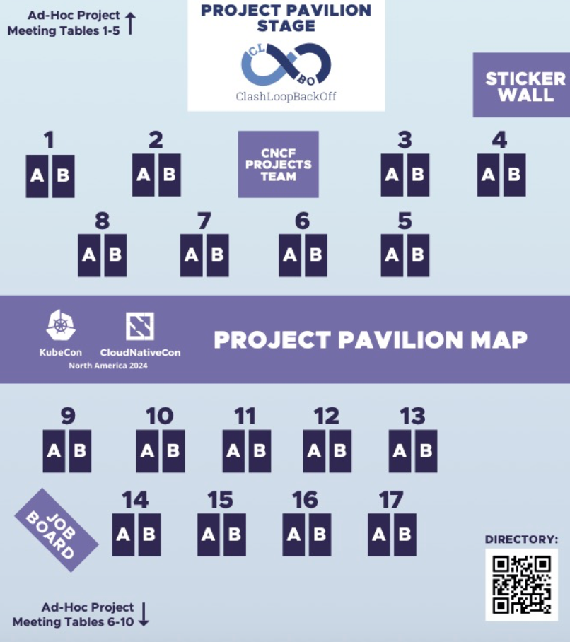
Where can I find KubeStellar at KubeCon NA 2024?
© 2023 IBM Corporation
Kiosk 2a
Thursday
Afternoon
@1-5pm
KUBESTELLAR.IO/JOINUS
21

Slide 22
Thank you!
© 2023 IBM Corporation
Andy Anderson
IBM Research Engineering Manager
—
andrew.anderson@ibm.com
@clubanderson
KUBESTELLAR.IO/JOINUS
22

